Slide 1

Intro Problem
Lines and Triangles:
Draw six line segments of equal length to form 8 equilateral triangles.

Slide 2

Intro Problem
Lines and Triangles:
Draw six line segments of equal length to form 8 equilateral triangles.

Slide 3
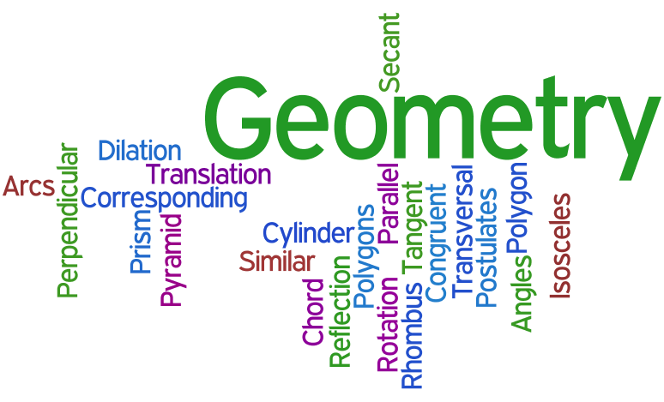

Slide 4
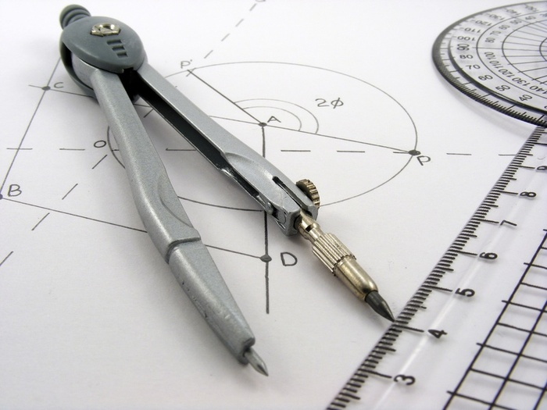

Slide 5
G-MA 153 Principles of Geometry
McPherson College Department of Mathematics
Assignment #3: Due Monday, Aug. 31, 2015
Complete each drawing using only
a pencil, compass, and straightedge.
PowerPoint with Videos available online:
DrawingLinesAndAngles.pptx
at www.webcoursework.com

Slide 6
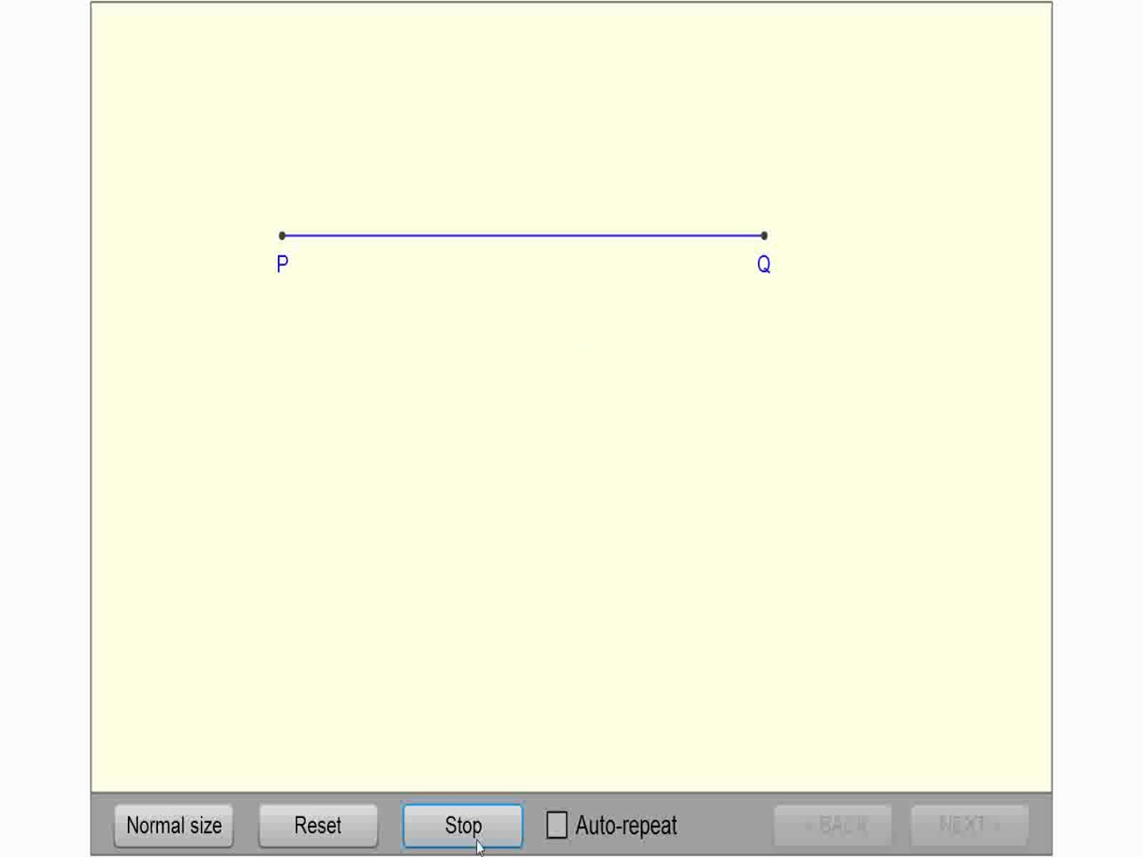
Congruent Lines

Slide 7
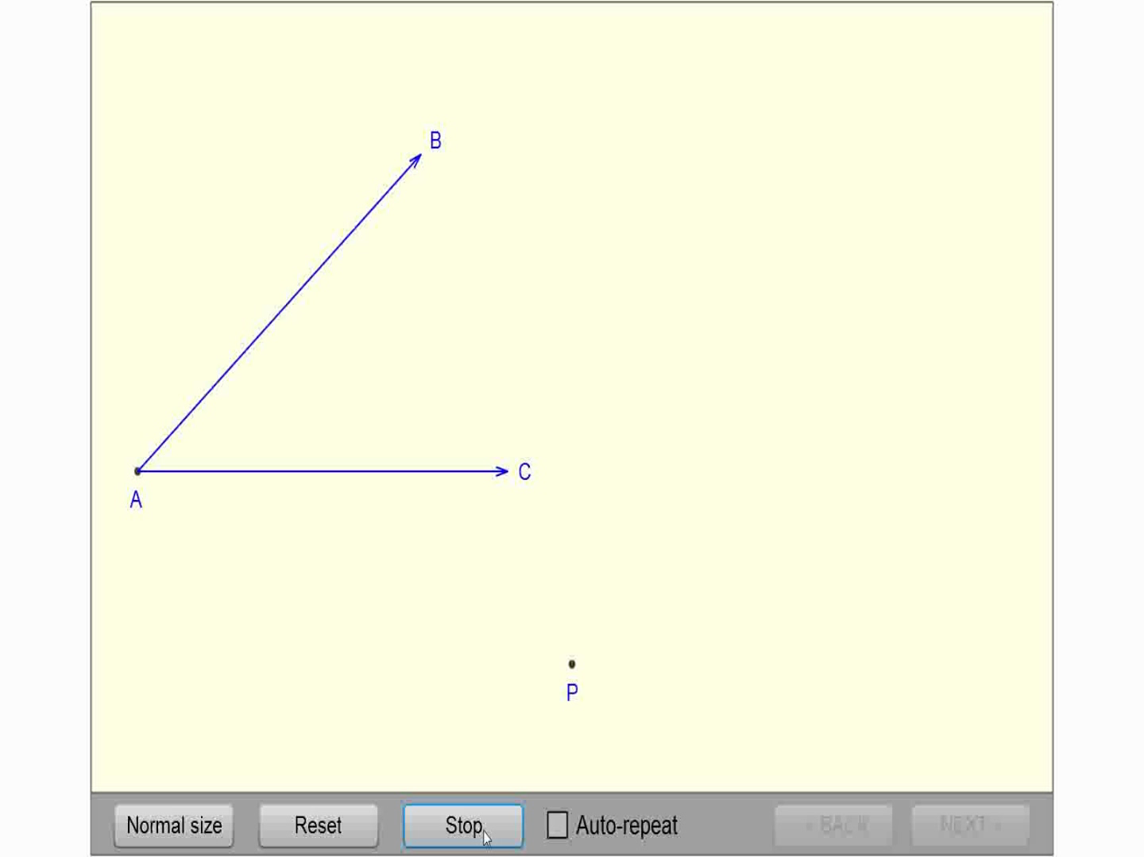
Copy an Angle

Slide 8
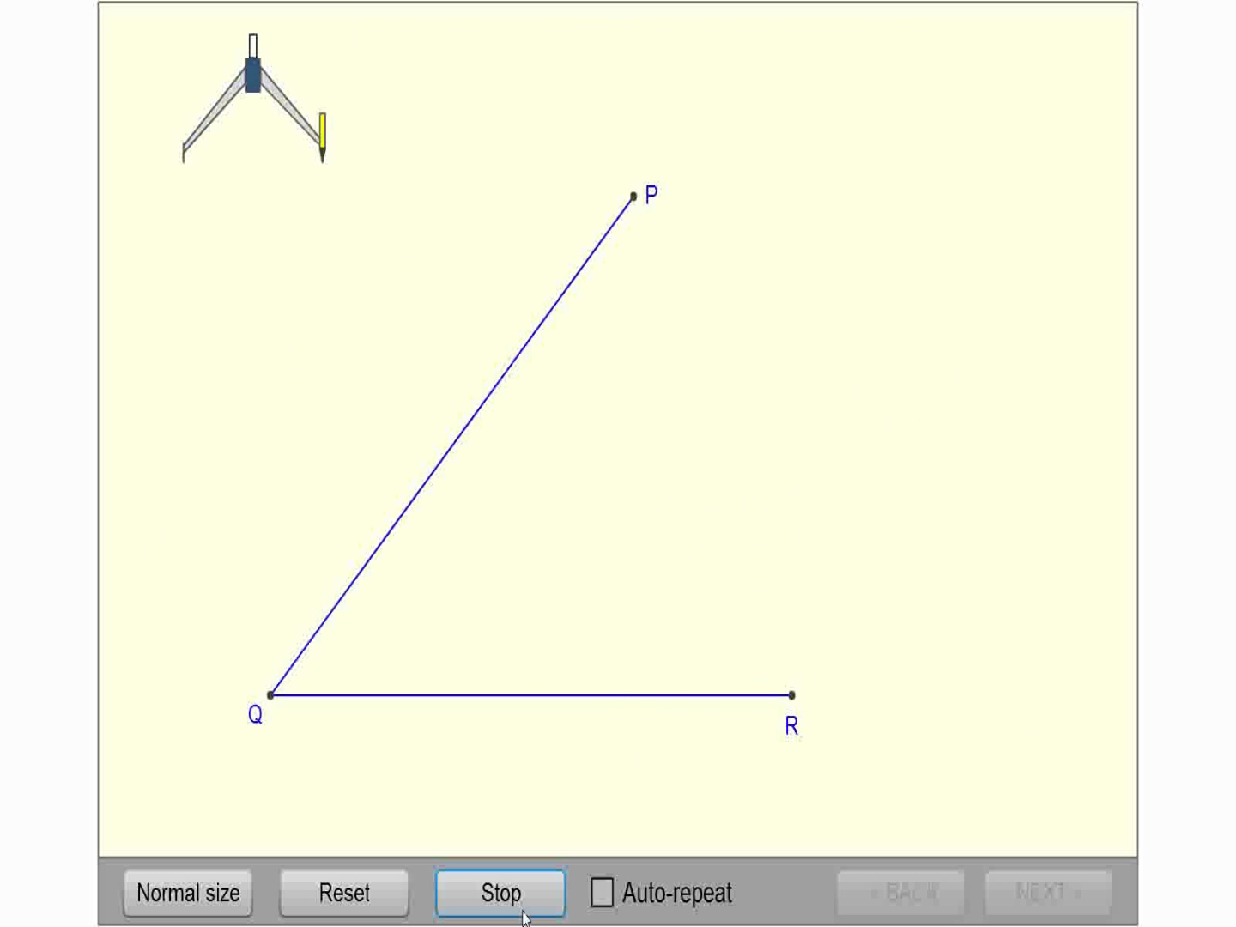
Bisect an Angle

Slide 9
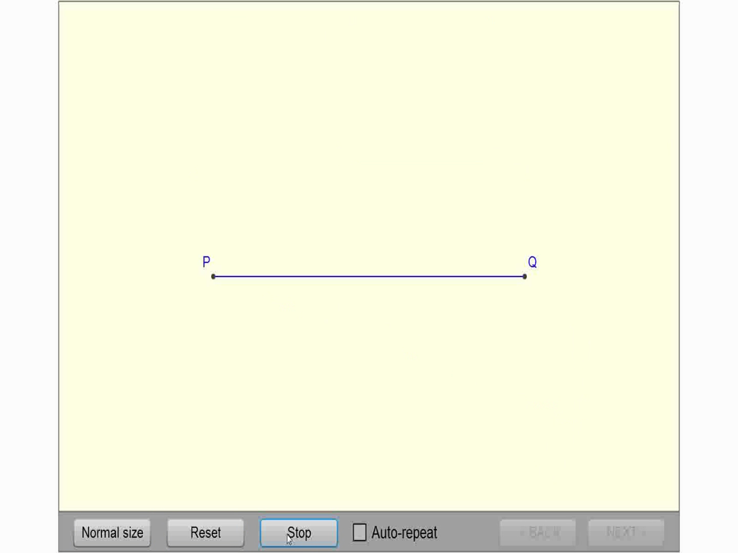
Perpendicular Bisector

Slide 10

Perpendicular Through a Point

Slide 11

Perpendicular At a Point

Slide 12

Parallel Lines

Slide 13

Parallel Lines Alternate

Slide 14
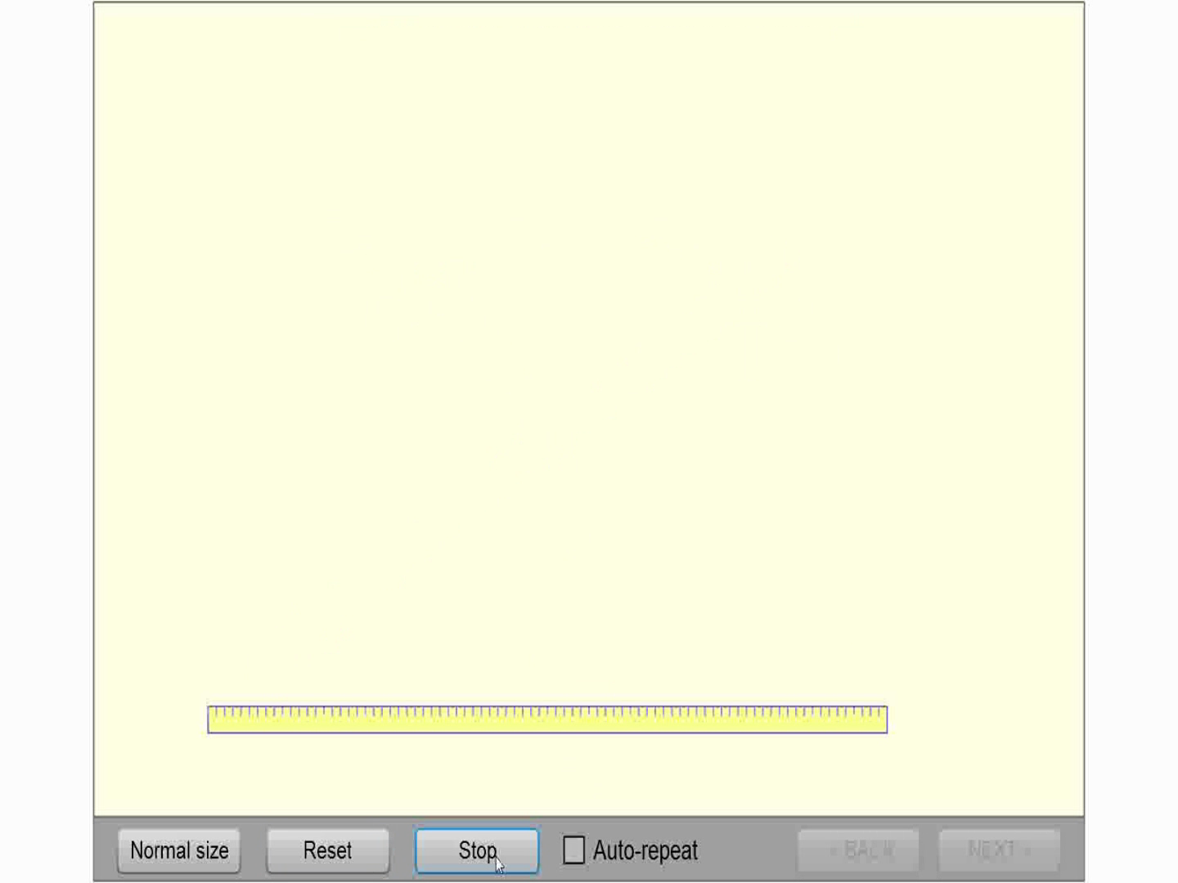
60º Angle

Slide 15
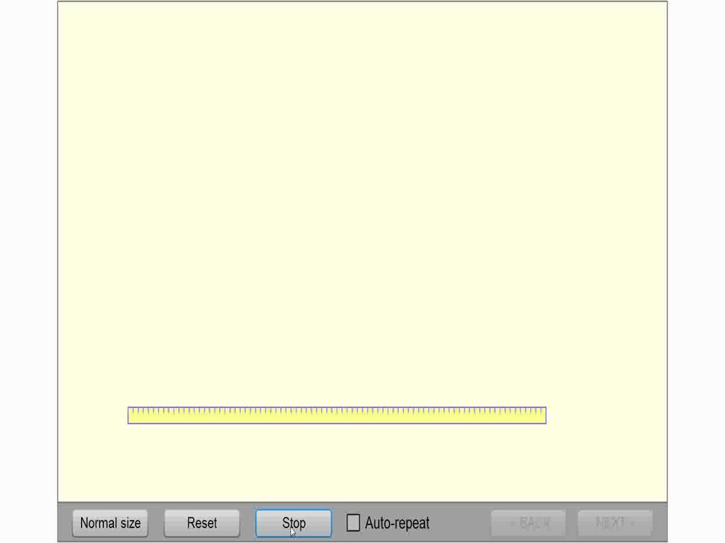
30º Angle

Slide 16

90º Angle

Slide 17
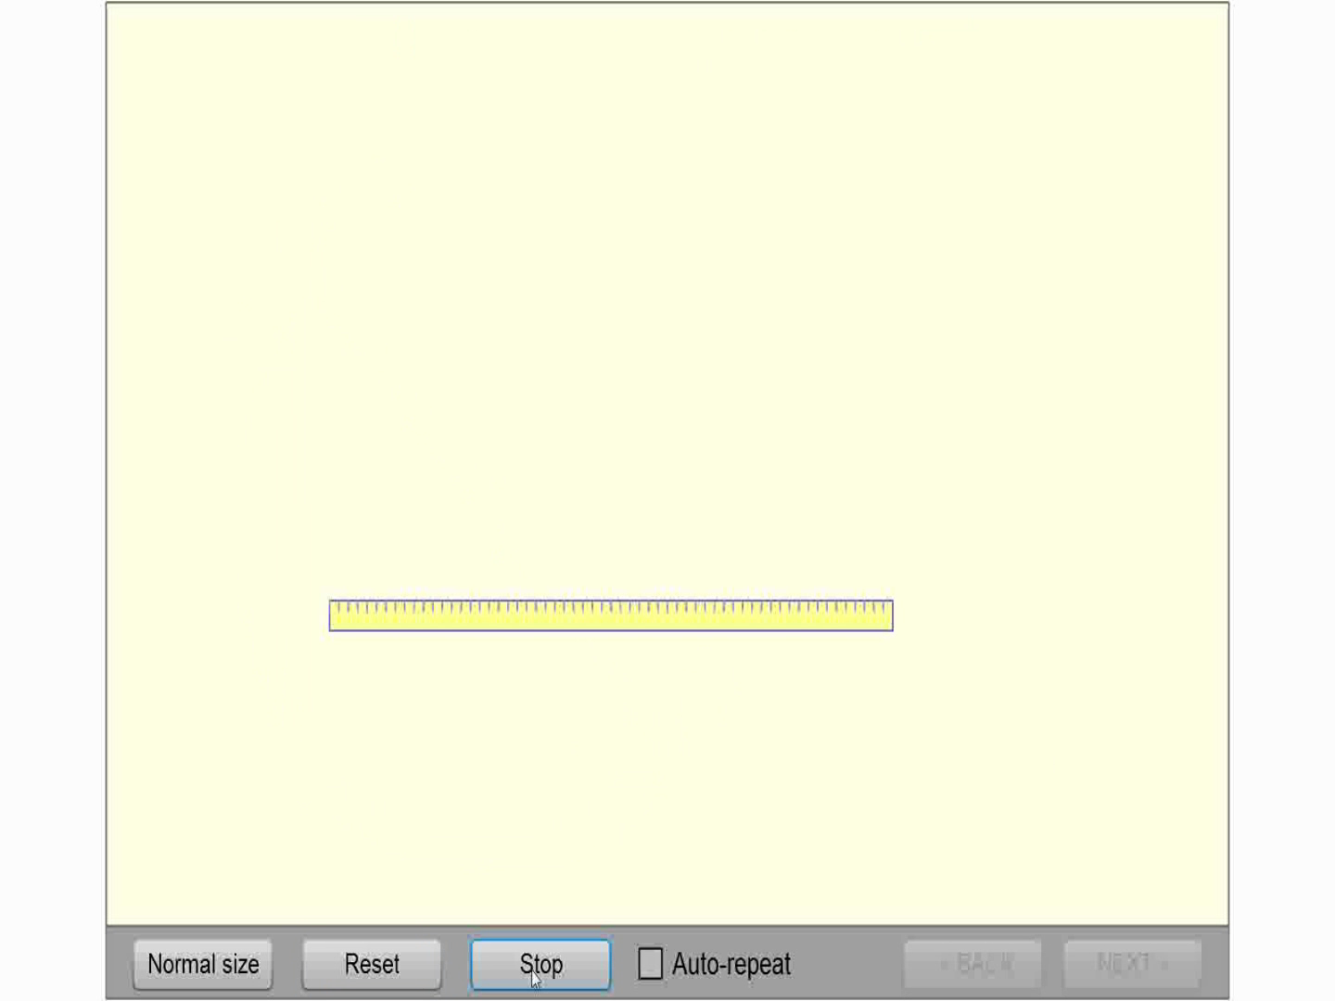
45º Angle

Slide 18

Find Center of a Circle

Slide 19

Inscribe a Hexagon within a Circle

Slide 20

Draw a Circle Through 3 Points

Slide 21
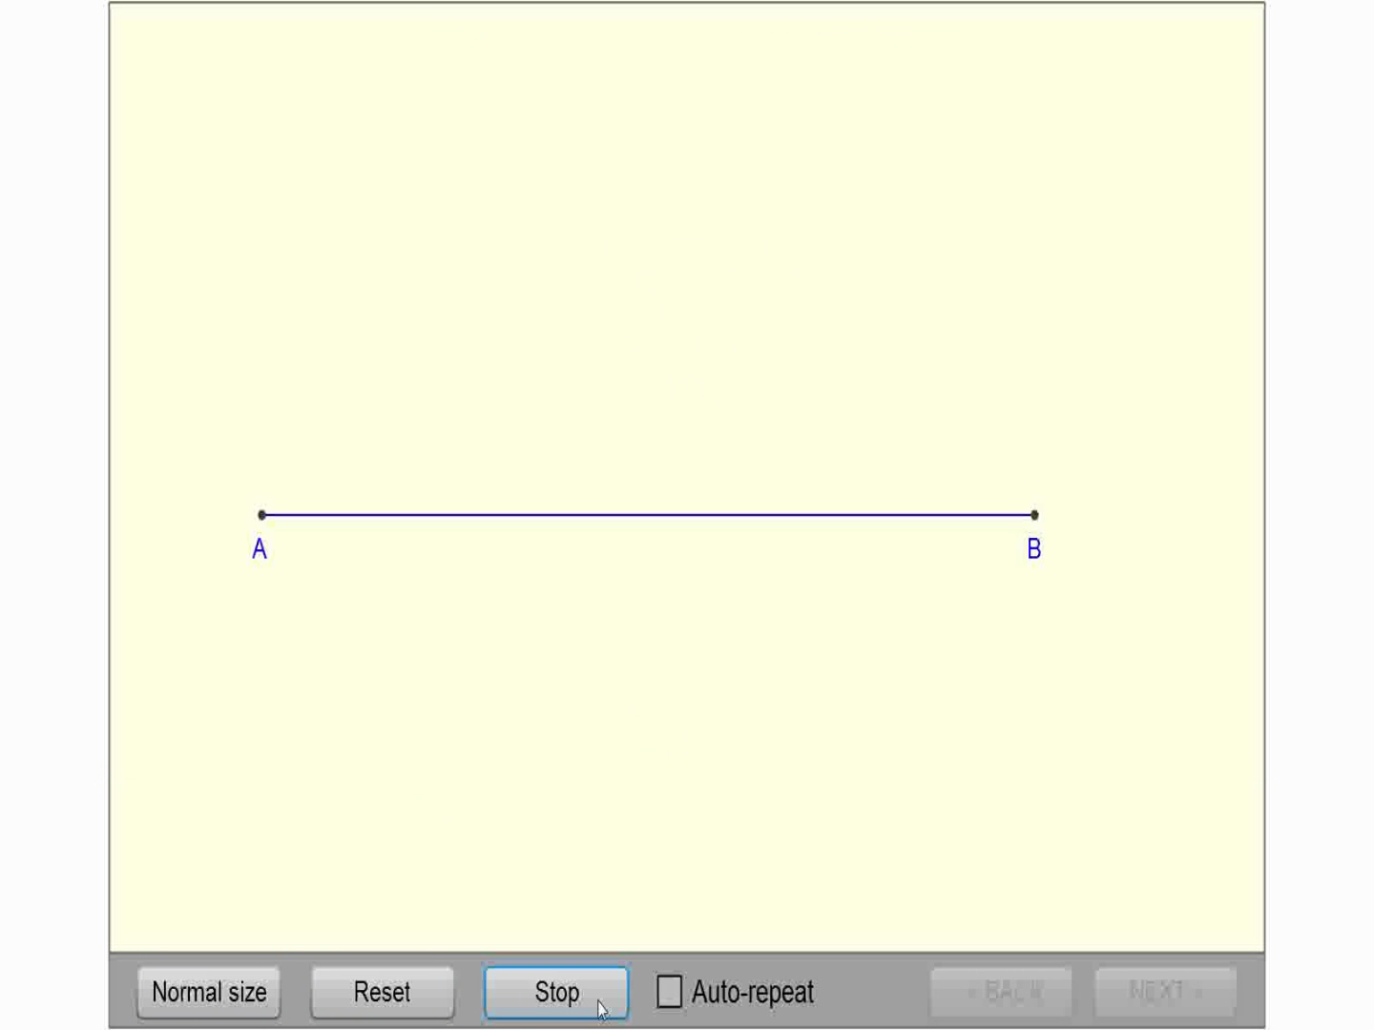
Divide a line into n segments

Slide 22
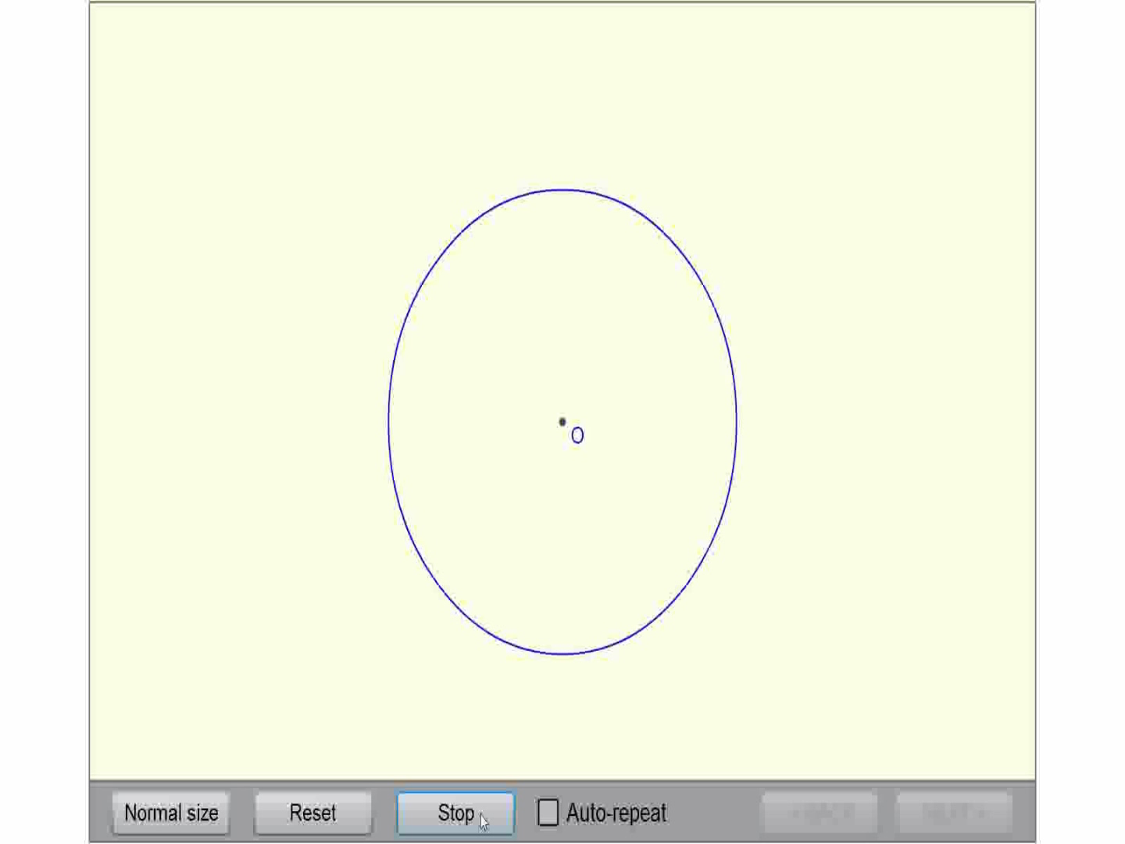
Inscribe a Pentagon within a Circle

Slide 23
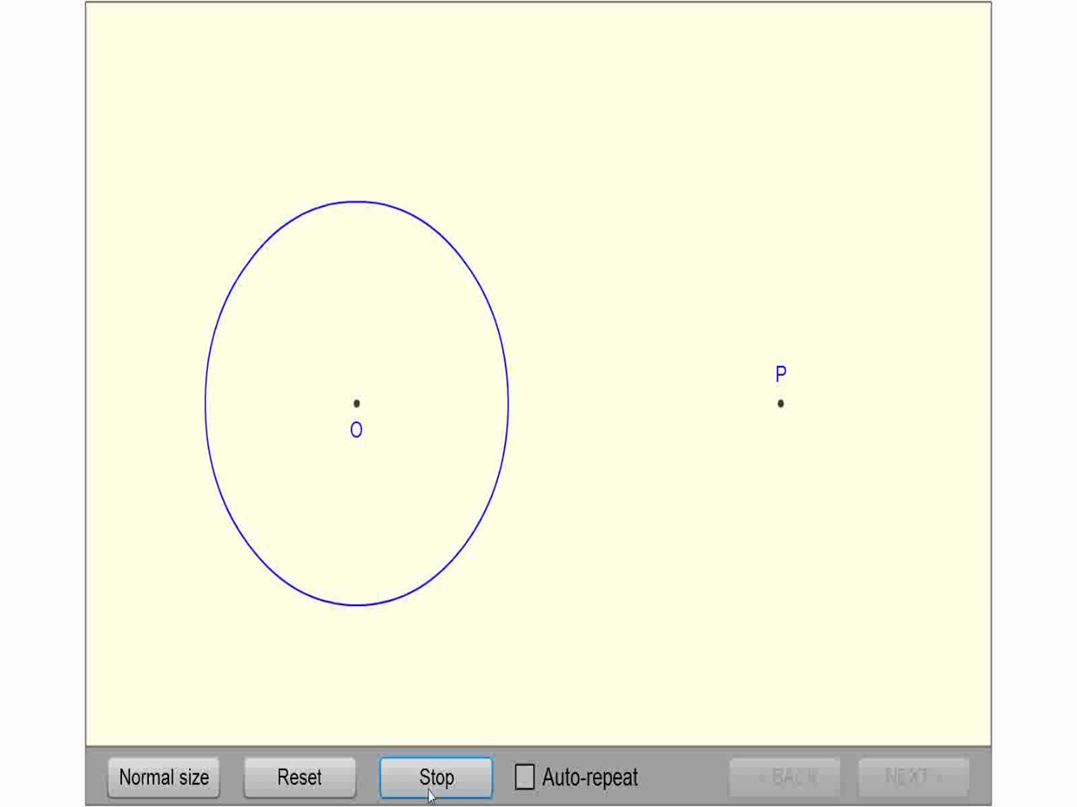
Tangents to a Circle Thru P

Slide 24
Notes:

